Slide 1
Communications Strategies for Vaccine Confidence:
Guiding One-On-One-Conversations
WEEK 4
November 4, 2021

Slide 2
The National Nurse-Led Care Consortium (NNCC) is a non-profit membership organization that supports nurse-led care and nurses at the front lines of care.
NNCC supports comprehensive, community-based primary care and public health nursing through policy and advocacy, program development and management, technical assistance and support, and direct, nurse-led healthcare services.
Notes:
The National Nurse-Led Care Consortium is a nonprofit member-supported organization working to strengthen community health through quality, compassionate, and collaborative nurse-led care.
NNCC represents the intersection of nurse-led primary care and public health.
Our mission is to advance nurse-led health care through policy, consultation, and programs to reduce health disparities and meet people’s primary care and wellness needs.
NNCC is an affiliate of the Public Health Management Corporation.

Slide 3
COVID Vaccine Project Goals
Empower nurses with necessary information to engage care teams and communities about COVID-19 vaccines.
Provide learning opportunities to share up-to-date guidance, support peer engagement among nursing colleagues, and strengthen the nursing role.
Amplify the nursing voice by featuring nurse champions through our podcast and other media outlets.
Notes:
NNCC is partnering with the Centers for Disease Control and Prevention (CDC) to build COVID-19 vaccine confidence among nurses and the communities they serve.
Through this project, we aim to:
Empower nurses with the necessary information to engage with care teams and communities about COVID-19 vaccines;
Provide learning opportunities to share up-to-date guidance and support peer engagement among nursing colleagues; and
Amplify the nursing voice by featuring everyday nurse champions through our podcast and other media.
Please visit nurseledcare.org to learn more.

Slide 4
AGENDA
Check-In (5 minutes)
Didactic Presentation (20 minutes)
Break Out Activity (10 minutes)
Report Out (5 minutes)
Discussion/Questions (10 minutes)
Close & Debrief (10 minutes)
NNCC VACCINE CONFIDENCE TRAINING

Slide 5
LEARNING OBJECTIVES
Outline common myths and misinformation related to COVID-19 vaccines.
Discuss strategies for nurses to engage the public around correcting misinformation.
Review use of NNCC’s campaign toolkit resources to provide accurate vaccine information.
Explore additional resources for healthcare providers to prepare for one-on-one vaccine conversations with patients and colleagues.
NNCC VACCINE CONFIDENCE TRAINING

Slide 6
MISINFORMATION AND VACCINE HESITANCY
NNCC VACCINE CONFIDENCE TRAINING

Slide 7
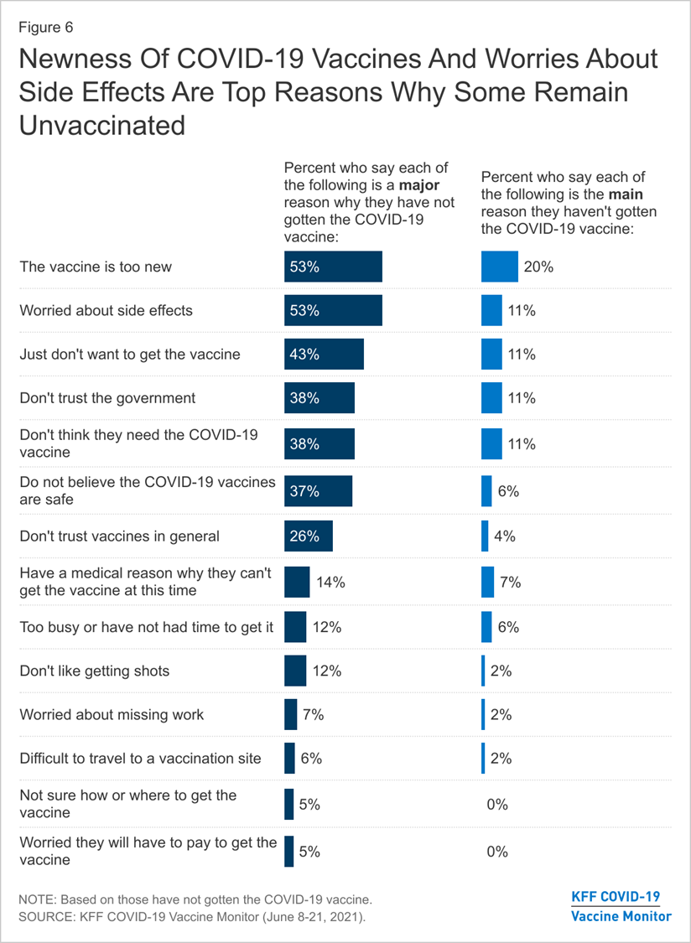
CURRENT LANDSCAPE
“The vaccine is too new”
“Worried about side effects”
“Just don’t want to get the vaccine”
“Don’t trust the government”
“Don’t think I need the COVID-19 vaccine”
NNCC VACCINE CONFIDENCE TRAINING
Source: https://www.kff.org/coronavirus-covid-19/poll-finding/kff-covid-19-vaccine-monitor-june-2021/
Notes:
When unvaccinated adults are asked to choose the main reason they have not yet gotten the COVID-19 vaccine, one in five cite the newness of the vaccine, followed by 11% each who say the main reason is that they are worried about side effects, they just don’t want to get the vaccine, they don’t trust the government, and they don’t think they need the vaccine.

Slide 8
MISINFORMATION + HESITANCY
We see misinformation falling into 3 main categories:
Head: Misinformation that misrepresents the facts around COVID-19 or the COVID-19 vaccine
Heart: Misinformation that causes an emotional response like fear or unease
History: Misinformation that is fueled by historical trends and negative interactions with healthcare providers and vaccines
NNCC VACCINE CONFIDENCE TRAINING
Notes:
Misinformation can cause hesitancy in a number of ways and it’s important to consider the basis of different pieces of misinformation in order to understand the true nature of someone’s hesitancy.

Slide 9
“FACTUAL” - HESITANCY
Here are a few examples of misinformation that can drive “factual” hesitancy:
“The COVID-19 vaccine puts a chip inside me to track me.”
“My body can better combat COVID-19 than the vaccine.”
“You can’t trust big government.”
NNCC VACCINE CONFIDENCE TRAINING
Notes:
Many community members feel like they have the facts when it comes to the COVID-19 vaccine but it’s important to probe for the “facts” they actually have.

Slide 10
EMOTIONAL HESITANCY
Here are a few examples of misinformation that can drive emotional hesitancy:
“The vaccine will impact my fertility or make me infertile”
“The vaccine causes a ton of side-effects - I’m going to feel worse than if I got COVID.”
“Many people I respect or care about are telling me the vaccine is bad.”
NNCC VACCINE CONFIDENCE TRAINING
Notes:
Misinformation can trigger emotional reactions in many people. It can cause fear, distrust, and anger.

Slide 11
HISTORICAL HESITANCY
Here are a few examples of misinformation that can drive historical hesitancy:
“They’re using this vaccine to test something on me.”
“They’re using the vaccine to kill me and other members of my race.”
“They’re using the vaccine to distract us from something important.”
NNCC VACCINE CONFIDENCE TRAINING
Notes:
For some patients and community members, hesitancy around the COVID-19 vaccine ties back to legacy concerns and distrust of the healthcare system.

Slide 12
BEST PRACTICES: COMMUNICATION
Validate Their Feelings Discussing the COVID-19 vaccine can be fraught with emotion and many people may feel defensive of their feelings. Start by validating their feelings of concern and letting them know you’re on their side.
Utilize Evidence-Based Information Many community members have been confronted with vast amounts of misinformation that fuels their hesitancy. Incorporate non-emotional, factual information that is tied back to reputable sources that resonate with your audience.
Reinforce Messaging with Personal Stories No one wants to be pressured into their decision. Help patients and community members know that they’re not alone by sharing your personal story with the COVID-19 vaccine.
NNCC VACCINE CONFIDENCE TRAINING
Notes:
With the overwhelming amount of information - and misinformation - out there about the COVID-19 vaccine, it’s understandable that many people have questions. When communicating with patients and community members, use these best practices to start an open conversation:
Validate Their Feelings Start by validating their feelings of concern and letting them know you’re on their side.
Utilize Evidence-Based Information Incorporate non-emotional, factual information that is tied back to reputable sources that resonate with your audience.
Reinforce Messaging with Personal Stories Help patients and community members know that they’re not alone by sharing your personal story or experience with the COVID-19 vaccine.

Slide 13
TODAY’S SPEAKER
NNCC VACCINE CONFIDENCE TRAINING
Notes:
And now, I’m excited to introduce today’s speaker, Dr. Letha Joseph!
Dr. Joseph is a Nurse Practitioner at Veterans Affairs Health Care System in Durham, North Carolina, and a consulting associate/ clinical instructor at Duke University School of Nursing.
Her research interests include health promotion and lifestyle modification, diabetes, cultural sensitivity and implicit bias, and older adults' care. She is a member of the American Nurses Association/ North Carolina Nurses Association, American Association of Nurse Practitioners, and Sigma Theta Tau International Honor Society of Nursing. Letha has received several accolades for recognition of her excellent work in nursing and academia.
She has presented with NNCC many times on the topic of misinformation and how to have productive vaccine conversations.
Welcome, Letha! Glad to have you back with us today.

Slide 14
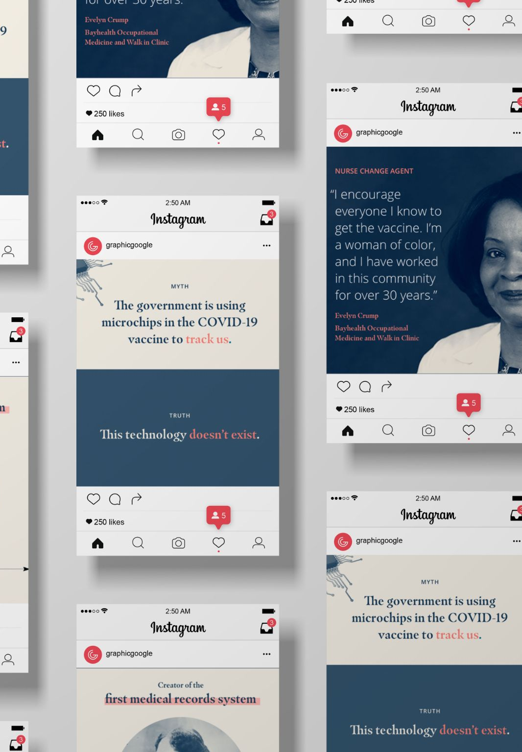
EFFECTIVE
ONE-ON-ONE CONVERSATIONS
NNCC VACCINE CONFIDENCE TRAINING

Slide 15
Prepare for Conversation
Pre-contemplation: Not considering change
Contemplation: Considering change
Preparation: Plan and commit to change
Action: Specific behavioral change
Maintenance of the behavior
An ongoing conversation, not a one-time event
Trust building is the key
Understand the ‘why’
Build together rather than feeling you must fix everything now
Resistance to change is normal
Prepare yourself to “create a psychologically safe environment”

Slide 16
Helpful Approaches
Assure
If you do not have all answers, assure that you will consult and comeback
Support
Support groups with authentic moderator
Empower
Make people competent to surf net and learn right information
Acknowledge
Acknowledge “lot of people accidentally believe incorrect information”

Slide 17
Avoid
Righting reflex
Missing cues
Using jargon
Discrediting information source
Questioning the intent of the source
Overstating vaccine safety
Confrontation , shaming

Slide 18
Dialogue
Guiding approach
Show openness and care
Ask what they already learned about topic
Ask about concerns and listen
Acknowledge and empathize
Ask permission to discuss
Assess openness/ readiness to new information
Share accurate information resources

Slide 19
Directing Style
“This is what you should do”
Guiding Style
“May I help you?”
“Maybe we could…” “Perhaps we should…”
“What do you think? How does that sit with you?”
“Only you can make this choice.”

Slide 20
Openness and Care
Body language
Distractions
“We can talk about this, but do you have other worries as well?”

Slide 21
Gather Information
Spend time to understand misinformation
Ask what they already learned about topic
Invite conversations about potential misinformation
“What have you already heard about ----------------------------?”
Ask about concerns and listen
Open-ended questions
“ What worries you about the vaccine?”
“Tell me what you are concerned about?”

Slide 22
Fully understand concerns and motivations
Do not minimize or dismiss their concerns
Acknowledge concerns
“I understand what you are saying”
Empathic responses
“You sound quite worried”
Acknowledge & Empathize

Slide 23
Assess readiness to receive facts
Ask permission before giving facts
Invite questions about what you just shared
Give credible resources- local hospital information page, CDC, WHO
Next Step- Discussing facts

Slide 24
BREAK OUT GROUPS
Practice Patient Scenarios
NNCC VACCINE CONFIDENCE TRAINING

Slide 25
Scenario 1 | Scenario 2 | Scenario 3 | Scenario 4
You are discussing COVID vaccine with a family member who says “I already had COVID. I do not need to be vaccinated” | You are discussing COVID vaccine with a coworker who states “COVID vaccine was developed too quickly. I suspect the safety of this vaccine” | You are discussing the COVID vaccine with a college student who states, “Vaccines can affect my ability to have a child”. | You are discussing COVID vaccine with a young adult who tells you “I am young and strong. I can handle COVID pretty well. I will be fine even if I get the virus”
NNCC VACCINE CONFIDENCE TRAINING

Slide 26
REPORT OUT
NNCC VACCINE CONFIDENCE TRAINING

Slide 27
QUESTIONS?
NNCC VACCINE CONFIDENCE TRAINING

Slide 28
TOOLS TO HELP COMBAT MISINFORMATION
NNCC VACCINE CONFIDENCE TRAINING

Slide 29
Notes:
NNCC recently launched a national campaign #NursesMakeChangeHappen and a COVID Vaccine Toolkit designed to give you the tools to support immunization in your community.

Slide 30
nurseledcare.org/toolkit
Notes:
You can check out our toolkit at nurseledcare.org/toolkit

Slide 31
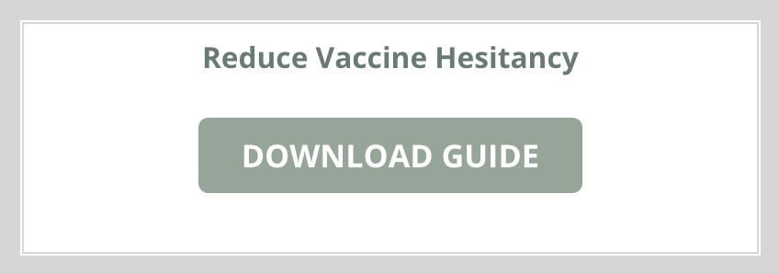
TOOLS TO HELP YOU COMBAT MISINFORMATION
Vaccine Misconceptions PDFs This selection of PDFs outlines the timeline behind the COVID-19 vaccine and provides specific factual information to respond to two major concerns.
Vaccine Hesitancy PDF This downloadable PDF will guide you through some of the main reasons or questions behind vaccine hesitancy and how to start conversations around them.
NNCC VACCINE CONFIDENCE TRAINING
Notes:
Our Nurses Toolkit includes a number of tools that can help you correct misinformation through factual communication
We have a selection of PDFs, called Vaccine Misconceptions, which outline the timeline behind the COVID-19 vaccine and provide specific factual information to respond to commonly asked questions about vaccine side effects and also about the vaccine trials.
We also have the Downloadable guide for addressing vaccine hesitancy. This steps through some of the main reasons or questions behind vaccine hesitancy and how to start conversations around them.

Slide 32
Learning Collaborative Feedback Survey Please complete our brief feedback survey Your responses will help us to assess the effectiveness of the training and improve future Learning Collaboratives.
Notes:
We kindly ask all participants to complete our brief Learning Collaborative Feedback Survey Your responses will help us to assess the effectiveness of the training and improve future Learning Collaboratives.
https://survey.alchemer.com/s3/6543153/ECHO-Learning-Collaborative-Survey-Fall-2021

Slide 33
REGISTER HERE!
Notes:
NNCC continues to host the Nurse-Led Forum for Vaccine Confidence webinar series.
Join us for our next webinar, TOMORROW, November 5th, where we’ll hear from Dr. Angela Richard-Eaglin, Associate Dean for Equity at the Yale School of Nursing. Together, we’ll explore applying cultural intelligence to understanding the impact of historic and systemic racism on vaccine hesitancy.
Register at the link here.

Slide 34
THANK YOU
Special thank you to all our NNCC members who make exceptional nurse-led programming possible.
Notes:
The National Nurse-Led Care Consortium is a member-supported non-profit organization. If you are not currently a member, please consider becoming one to support nurse-led care. Learn more on nurse led care dot org.

Slide 35
Notes:
Thank you again to our speakers and attendees.
Please complete the post-session quiz to receive CE credits. The link to the quiz will be available in the Google Drive Folder in the next couple days. We will also share the link by email when available.
This concludes our learning collaborative.

